Slide 1

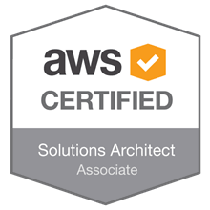
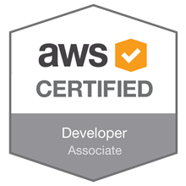
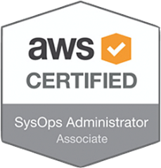
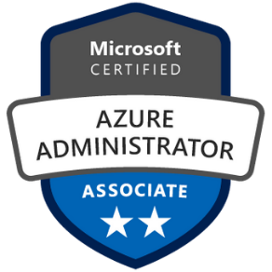



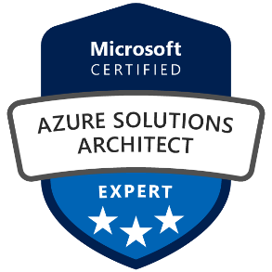
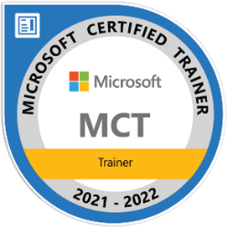
Azure Migration & Modernization Assessment
An Quoc Huy
Microsoft certified trainer

Slide 2
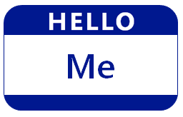
Hello! Instructor Introduction
Instructor: An Quoc Huy
Cloud Solution Architect
Microsoft Certified Trainer
FPT Software

Slide 3

Hello! Student Introductions
Let’s get acquainted:
Your name
Company affiliation
Title/function
Experience
Your expectations for the course

Slide 4
Course Agenda
01 – Course introduction
02 – Assessment process
03 – Migration process
04 – Migration Lab

Slide 5
Course introduction
Module 1
An Quoc Huy
Microsoft certified trainer

Slide 6
Azure Migration & Modernization Assessment
Course introduction:
The course provides knowledge, assessment and migration process to Azure rehost (Lift and Shift)
Provide tools and templates to work on Assessment and migration projects
Target:
After the course, students can participate in an assessment and migration project from on-premises to Azure.
Understand assessment and migration methodology
Outcome:
By the end of this workshop, students will be ready to participate in projects on Assessment, and Migration
Prerequisites:
Azure fundamental (Az-900)
Recommended experience: 1+ years hands-on experience Azure
Content:
Concepts, Principles, Methodology, Tools, Templates.
Case study
Migration Lab

Slide 7
Challenges
Internal IT Operation
Cost Optimization
Complex Security & Compliance
Business Continuity
Expertise & Knowledge
Advisory & Strategic Development
Ineffective management of cloud expenditure
No method of cost optimization
Difficulties in budget forecasting
Lack of reference or high-level advisory to help with critical enhancement or strategic revolution
Lack of strategies & methodologies to handle critical issues
Detecting and preventing intrusions
Ongoing updates, monitoring and management
Overwhelmed of too many complex compliance requirements
Shortage of highly-skilled engineers
Lack of skills & expertise to satisfy the breath of technologies needed
Hard to keep up with fast-changing technologies
Lack of resources involvement to ensure business continuity 24/7
Insufficient tools and technology to prevent painful downtime
Lack of routine testing

Slide 8

Journey to Cloud
Application
Cloud
Cloud
Modernization
Data
Migration
Infrastructure
Re-host
Redeploy as-is to cloud
Refactor
Re-architect
Materially alter/decompose application to services
Rebuild
New code written with
Cloud-Native approach
Replace
Discard existing apps & use
commercial software
Description
Minimally alter to take
better advantage of cloud
Reduce Capex
Free up datacenter
space
Quick cloud ROI
Faster, smaller updates
Code portability
Greater cloud efficiency
App scale and agility
Easier adoption of new cloud capabilities/ technologies
Mix technology stacks
Accelerate innovation
Build apps faster
Reduce operational cost
Standardizing around industry best
practices
Accelerating adoption of business process-driven approaches
Reallocating development investments
Business Drivers
(resources, speed, cost)
IaaS
Containers
PaaS Serverless M*-services
SaaS
Core Technologies
PaaS IaaS
Business Results
IaaS: 435% ROI, 73% reduction in PaaS: 466% ROI, 80% time saved, 5.91M NPV, 50% faster deployments.
datacenter footprint and 83% Container: 13x more releases, 10x cost reduction, 65% faster developer onboarding, 62% better availability. reduced IT outsourcing cost.
Notes:
https://docs.microsoft.com/en-us/azure/cloud-adoption-framework/digital-estate/5-rs-of-rationalization

Slide 9
Assessment process
Module 2
An Quoc Huy
Microsoft certified trainer

Slide 10
Assessment and planning
Why do you need assessment and planning service?
A large and complex system
Outdated technology
Difficulty evaluating and planning to migrate to the Cloud
Difficulty budgeting
Difficulty choosing technology when migration to Cloud
Difficulty choosing resource configuration when migrating to Cloud
What is App, Data & Infrastructure Assessment?
Assessments provide the customer with an end-to-end analysis and mapping of their entire IT estate, taking into consideration current deployment, usage, processes and data. The analysis will be the basis for the evaluation of your overall infrastructure in relation to on-premises and cloud-strategy, helping the customer optimize their current application and server workloads while providing insights on the business and technology benefits to moving additional workloads to the cloud.
Critical Key Findings:
Remediate Windows Servers which are no longer supported or at the end of Extended Support.
Plan for Windows Server 2012, SQL Server 2014 upcoming end of life events.
This engagement will provide you with key insights on the following:
Up-to-date Infrastructure landscape
Cloud readiness
Cloud total cost of ownership (TCO)
Cloud migration roadmap

Slide 11






Design the big picture with Cloud discovery
Definition
Analysis & Assessment
Solution & Plan
Understand
Analyze
Identify
Design
Establish
Vision & Motivations
Expected Business Outcomes
Technology Challenges, Pain Points
Organization Skills, Process
Current State (App, Data, Infra Inventory, Security, Operational Requirements)
Current State Modelling
Application Dependency
Application Criticality
Business Impacts
Gap Analysis
Application Evaluation Scorecards
Application Transformation Priority
Application Transformation Strategy (Re-host, Refactor, Re-architect, Rebuild, Replace)
Landing Zone & System Landscape on Cloud
Reference Architectures
Cloud Transformation Roadmap/Plan
Application Transformation Pilot
Project Organization
Cost Model (TCO)
Review - Adjust - Align - Consent
DECISION GATES
Framework
& Tools
Azure Migrate
Azure DMA
Azure SSMA
MAP Toolkit
CloudRecon
CloudPilot

Slide 12
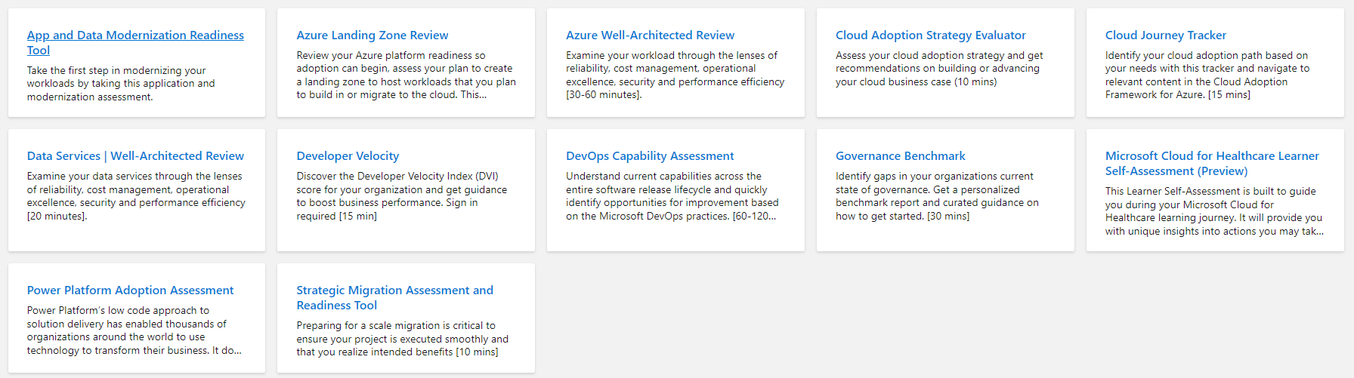
Welcome to Microsoft Assessments
https://docs.microsoft.com/en-us/assessments/

Slide 13
Approach and methodology
Plan
“An iterative process that supports your business … as it evolves”
Govern
Manage
Define strategy
Adopt
Ready

Slide 14
Approach and methodology
Adopt
Define Strategy
Understand motivations
Business outcomes
Business justification
Prioritize project
Plan
Digital estate
Initial organization alignment
Skills readiness plan
Cloud adoption plan
Ready
Readiness guide
First landing zone
Expand the blueprint
Best practice Validation
Migrate
• First workload migration
• Expanded scenarios
• Best practice validation
• Process improvements
Innovate
• Innovation guide
• Expanded scenarios
• Best practice validation
• Process improvements
Govern
Methodology • Benchmark
initial best practice • Governance maturity
Manage
Business commitments
operations baseline • Ops maturity
https://docs.microsoft.com/en-us/azure/cloud-adoption-framework/

Slide 15
Define strategy
Documenting the cloud strategy will help business stakeholders and technicians understand the benefits the organization is pursuing by adopting the cloud.
Define strategy
Plan
Ready
Adopt
Govern
Manage
Motivations
Executive mandate
DC Exit
Merger and acquisitions
Cost savings
Optimization
Agility
Tech capabilities
Market demands
Geo expansion
Migration
Innovation
Business outcomes
Fiscal: revenue, cost, profit
Agility: timer to market, provisioning,
Reach: global access, sovereignty
Customer engagement: cycle time, from request to release
Performance: SLAs, Downtime, operations, reliability
Business justification
Business case: the cloud is not always cheaper, mirroring is not cloud, servers drive cost analysis
Financial model: Capex/ Opex, ROI, gain, cost avoidance/reduction
Cloud accounting: cost center, procurement, profit center, revenue generating, chargeback
First project
Business criteria: workload supported by a BDM
Technical criteria: minimum dependencies and test path, no governance
Qualitative analysis: Current Team analysis

Slide 16
Plan
Cloud adoption plans convert the aspirational goals of the cloud adoption strategy into actions. It will help guide technical efforts, in alignment with the business strategy.
Define strategy
Plan
Ready
Adopt
Govern
Manage
Digital estate
Rationalization: inventory
Quantitative analysis: asset optimized and sized properly
Qualitative analysis: operational process
Initial organization alignment
Cloud Strategy Team
Business IT: requirements and needs
IT management operations: traditional IT
Governance: executive sponsor, finance, business leadership, legal, security, HR
Cloud platform vendor: account success team
Cost management
IT-business alignment
Governance MVP
Skill readiness plan
Organizational readiness
Governance and security alignment
Initial organization alignment
Building technical skills: business/technical, and certifications
Change management guidance
Cloud adoption plan
5R strategy: rehost, refactor, rearchitect, rebuild, replace
Infrastructure migration: VM, server, database focus
Application innovation: born in the cloud applications, APIs
Data-driven innovation: Focus on data consolidation and analysis

Slide 17
Ready
Ready establishes a cloud foundation or Adoption Target that can provide hosting for any adoption efforts. This should consist of common denominators across 80–90% of cloud adoption.
Define strategy
Plan
Ready
Adopt
Govern
Manage
readiness guide
Resource management: management groups, subscriptions, resource groups, resources tree hierarchy
Naming Standards
Resource tags
Landing zone infrastructure
Network design: Vnet, hybrid, firewall, hub, front door, endpoints
Storage design: disk, file, blobs, CDN
Compute design: VMs, containers, apps, serverless
Data design: Structured/ unstructured
Landing zone ID
Identity and access
Role-based access control RBAC
Manage to least privilege
Landing zone cost
Costs and billing
Analyze Cloud Costs
Monitor with budgets
Optimize with recommendations
Manage invoices and payments
Blueprints
AI
BigData
Hybrid networks
Identity management
IoT
Serverless
SAP
VMs
WebApps
DevOps

Slide 18
Adopt: Migrate
Cloud adoption will include workloads which do not warrant significant investments in the creation of new business logic. These workloads are candidates for migration to the cloud.
Define strategy
Plan
Ready
Adopt
Govern
Manage
Assess
Evaluate assets and establish a plan
Validate pre-requisites: landing zone, skilling
Drivers: reducing capex, freeing up DC
Quantitative factors: VMs, networking, compatibility
Qualitative factors: process dependencies, critical business events
Migrate: rehost
Replicate (lift and shift) on-prem functionality using cloud native technology
Leverage Azure Migration Guide
Optimize
Balance performance and price
Deliver the right experience within budget
Resize VM size, resize storage, resize database
Secure and manage
Prepare the migrated asset for ongoing operations: security, monitoring, configuration

Slide 19
Adopt: Innovate
Older apps can take advantage of many of the same cloud-native benefits by modernizing the solution or components of the solution. Modern DevOps invites into the process to create shorter feedback loops and better customer experiences.
Define strategy
Plan
Ready
Adopt
Govern
Manage
Infrastructure abstraction
Cloud native applications built from the ground up optimized for cloud:
Resiliency
Global scale
Agility
Security
Autoscaling
Innovate: refactor
Refactoring an application to fit a PaaS/Serverless-based model or refactoring code to deliver on new business opportunities.
Drivers: faster and shorter updates, code portability, greater cloud efficiency (resources, speed, cost)
Innovate: rearchitect
Modify existing applications into managed containers to take advantage of cloud native benefits
Drivers: application scale and agility, easier adoption of new cloud capabilities, mix of technology stacks
Innovate: rebuild
A new code base is created to align with a cloud-native approach. App Data and AI Services
Drivers: accelerate innovation, build apps faster, reduce operational cost
DevOps
Culture
Development
Testing
Release
Monitoring
Management

Slide 20
Govern
Policy definition ensures consistency across adoption efforts. Alignment to governance/compliance requirements is key to maintain a well-managed cross-cloud environment.
Define strategy
Plan
Ready
Adopt
Govern
Manage
Business risk
Document evolving business risk
Document risk tolerance based on data classification, and application criticality
Policy & compliance
Convert risk decisions into policy statements
Establish cloud adoption boundaries
Processes
Establish processes to monitor violations
Adhere to corporate policies
Cloud Center of Excellence
Cost management
Evaluate and monitor cost
Limit IT spend
Scale based on business demand
Create cost accountability
Security baseline
Compliance with IT Security requirements
Apply security baseline to all adoption efforts
Resource consistency
Consistency in resource configuration
Enforce on boarding, recovery and discoverability practices
Identity baseline
Enforce identity and access baseline
Apply role definitions and assignments
Deployment acceleration
Centralize templates
Drive consistency and standardization

Slide 21
Manage and operations
Manage and operations enumerates, implements, and iteratively reviews related to the expected operational behavior of the service.
Define strategy
Plan
Ready
Adopt
Govern
Manage
Management
Identify critical operations for business operations
Map operations to services
Analyze services dependencies
Create high level view service dashboards
Monitoring
Enable data collection
Identify operations baseline
Generate alerts
Measure Service Metrics and generate SLAs
Resiliency
Enable a resilient platform
Recover from failures with minimal downtime and minimum data loss before
Evolve to a highly available platform

Slide 22
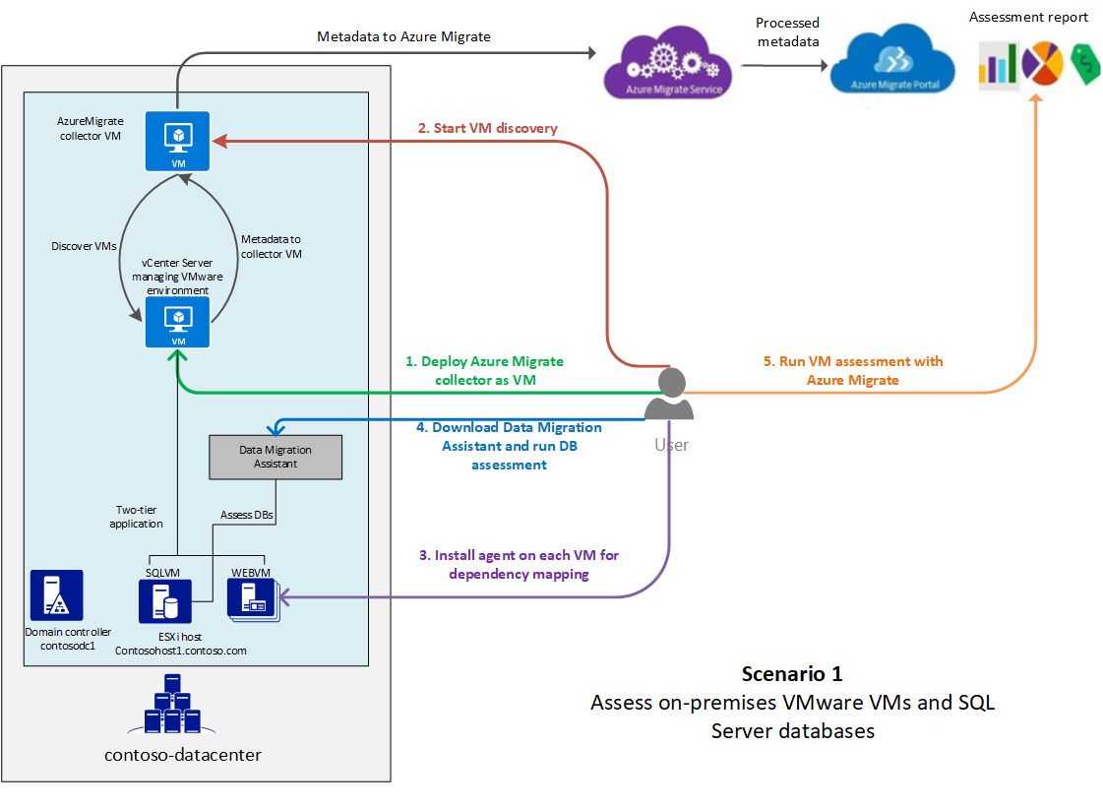
Example: Assessment architecture
Contoso is a fictional name that represents a typical enterprise organization.
Contoso has an on-premises datacenter (contoso-datacenter) and on-premises domain controllers (CONTOSODC1, CONTOSODC2).
VMware VMs are located on VMware ESXi hosts running version 6.5 (contosohost1, contosohost2).
The VMware environment is managed by vCenter Server 6.5 (vcenter.contoso.com, running on a VM).
The SmartHotel360 travel app has these characteristics:
The app is tiered across two VMware VMs (WEBVM and SQLVM).
The VMs are located on VMware ESXi host contosohost1.contoso.com.
The VMs are running Windows Server 2008 R2 Datacenter with SP1.
The VMware environment is managed by vCenter Server (vcenter.contoso.com) running on a VM.
The osTicket service desk app:
The app is tiered across two VMs (OSTICKETWEB and OSTICKETMYSQL).
The VMs are running Ubuntu Linux Server 16.04-LTS.
OSTICKETWEB is running Apache 2 and PHP 7.0.
OSTICKETMYSQL is running MySQL 5.7.22.
https://docs.microsoft.com/en-us/azure/cloud-adoption-framework/plan/contoso-migration-assessment

Slide 23
Case study 1: Education (Infra, App and Database)
Scope of the assessment:
25 systems assessed
25 Windows
0 Linux
5 Applications
3 Web Application (PHP 1, .Net 2)
2 Win Form (.Net)
4 Databases
SQL Server 2014
Method:
Deployed Azure Migrate, App CloudPilot
Resource consumption data collected from CPU, RAM, Storage and I/OPS Utilization
Data collected by Azure Migrate was proceeded through CloudRecon to generate economic analysis.
Data collected by App CloudPilot was proceeded through CloudPilot to generate economic analysis.
Critical Key Findings
Remediate Windows Servers which are no longer supported or at the end of Extended Support.
Plan for Windows Server 2012, SQL Server 2014 upcoming end of life events.

Slide 24
Case study 2: Energy (Infra, App and Database)
Scope of the assessment:
56 systems assessed
Azure Ready 41 VMs
39 Windows
2 Linux
Ignored Machines
15 VMs
4 Applications
3 Web Form (Java 1, .Net 2) (Tool)
1 IoT System (Manual)
3 Databases
1 PostgreSql
2 MSSQL
Method:
Deployed Azure Migrate, App CloudPilot
Resource consumption data collected from CPU, RAM, Storage and I/OPS Utilization
Data collected by Azure Migrate was proceeded through CloudRecon to generate economic analysis.
Data collected by App CloudPilot was proceeded through CloudPilot to generate economic analysis.
Critical Key Findings
Remediate Windows Servers which are no longer supported or at the end of Extended Support.
Plan for Windows Server 2012, 2008 upcoming end of life events.

Slide 25
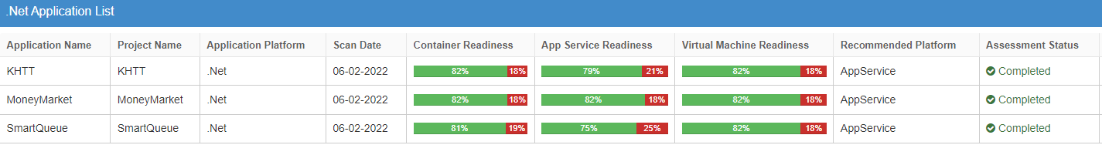
Case study 3: Bank (App and Database)
Scope of the assessment:
7 systems assessed
5 Windows
2 Linux
3 Applications
3 Web form (ASP.NET MVC)
5 Databases
2 Oracle
3 MSSQL
Method:
Deployed App CloudPilot
Resource consumption data collected from CPU, RAM, Storage and I/OPS Utilization
Data collected by App CloudPilot was proceeded through CloudPilot to generate economic analysis.
Critical Key Findings
Remediate MSSQL Servers which are no longer supported or at the end of Extended Support.
Plan for MSSQL Server 2012 upcoming end of life events.
Application Listing:

Slide 26
Migration process
Module 3
An Quoc Huy
Microsoft certified trainer

Slide 27
Migration
Microsoft Azure Immersion Workshop:
Infrastructure Migration
Notes:
https://azure.microsoft.com/en-us/migration/#overview

Slide 28
Migration Lab
Module 4
An Quoc Huy
Microsoft certified trainer

Slide 29
Migration Lab
https://github.com/microsoft/MCW-Line-of-business-application-migration

Slide 31


